Slide 1
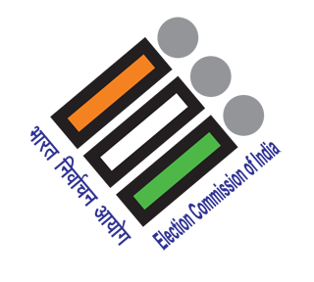


Welcome to the
Indian Election Analysis
DISCLAIMER
This is an Unguided Data Analysis Project Work as part of Codebasics Resume Challenge 11,
to showcase various skills which are very frequently used in data analysis processes. Dataset used in this project has been taken from Challenge documents itself. Apart from this some specific data like SGDP and Literacy Ratio for further analysis are taken from Internet. I have used Excel, SQL, PowerPoint and Web-Searches for different purposes throughout this project.
I believe my work will provide AtliQ Media with unique and sufficient content on Indian Elections of 2014 & 2019 for there show on Lok Sabha Elections of 2024.

Slide 2
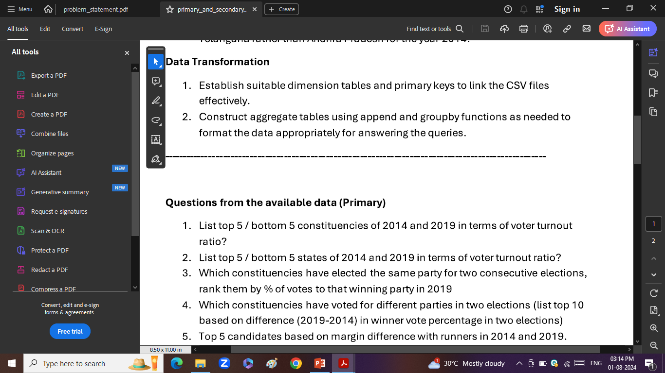
Questions Familiarity
Any Data Analysis project begins with good understanding of the questions we are trying to solve. For this project my senior has created some fundamental questions that I have tried to solve.
Some questions are very straight forward where as some are quite complicated. I have looked at each questions and thoroughly understood the demand of these questions.
All questions are here.

Slide 3
Understanding Metadata
1. constituency_wise_results_2014
2. constituency_wise_results_2019
3. dim_states_codes
*******************************************
- state: The name of the state where the election is held. This indicates the geographical location within India where the electoral process takes place.
- pc_name: Short for Parliamentary Constituency Name. This column identifies the specific electoral district within the state from which representatives are elected to the Lok Sabha.
- candidate: The name of the individual running for election. This is the person who is contesting in the election to become a Member of Parliament (MP).
- sex: The gender of the candidate. Typically denoted as 'M' for male and 'F' for female.
- age: The age of the candidate at the time of the election. This is given in full years.
- category: Refers to the reserved status of the candidate under Indian affirmative action policies, such as Scheduled Castes (SC), Scheduled Tribes (ST), or unreserved/general.
- party: The name of the political party that the candidate represents. If the candidate is not affiliated with any party, they are listed as an independent (IND).
- party_symbol: A unique symbol or logo assigned to the political party, which appears on the ballot paper. Independent candidates may have unique symbols that are not associated with a recognized party.
- general_votes: The number of votes the candidate received during the general voting phase. This does not include postal votes.
- postal_votes: The number of votes the candidate received via postal voting, which is typically used by voters who are unable to present themselves at the polling station on the day of the election.
- total_votes: The total number of votes received by the candidate, which is the sum of general votes and postal votes.
- total_electors: The total number of registered voters in the constituency. This gives an idea of the electoral size and the potential voter base from which the candidate can draw support.
*******************************************
dim_states_codes:
- state_name: This column contains the full official names of states and union territories in India.
- abbreviation: The abbreviation column lists the standard two-letter codes assigned to each state and union territory.
*******************************************
Key Metrics:
Voter Turnout Ratio: This metric represents the percentage of registered voters who actually cast their votes in an election. It is calculated by dividing the total number of votes cast (general votes plus postal votes) by the total number of registered electors in a constituency, and then multiplying by 100 to convert it into a percentage. This ratio is a crucial indicator of voter engagement and participation in the democratic process.
Voter Turnout Ratio = (Total Votes Cast / Total Electors) × 100%

Slide 4
Data Cleaning & Transformation
1. constituency_wise_results_2014
2. constituency_wise_results_2019
3. dim_states_codes
*******************************************
No duplicate values are there.
We have Null values in age, sex and category columns. A close look at data suggest that these null values are associated with None Of The Above/NOTA in candidate column. By nature NOTA is not a person or a party therefore it cannot have age,, sex and category. Therefore we replace these Null values under sex and category columns with NOTA and, with 0 in age columns to ensure datatype consistency.
Ensuring data are consistent with expected data types of columns
New Columns:
Year: election year 2014 or 2019
State_pc : unique id for each constituency. State abbreviation + constituency name
New dimension tables:
pc_total_electors_2014
pc_total_electors_2019
fact_table_all_data
gdp_table
literacy_table

Slide 5
Loading Data in Pgadmin 4
Created new database as election_data
Created tables using CREATE TABLE (column DATA_TYPE)
Imported data to this tables using Import from CSV file
Ensuring all table are successfully imported and holding proper values by using SELECT * FROM table
Perfect. All fine. We are good to begin with our analysis
NOTE: Up coming slides are answers only and not actual queries to our questions using SQL. However you can refer and review all queries here.

Slide 6
National Picture of both Election 2014 & 2019

Slide 7
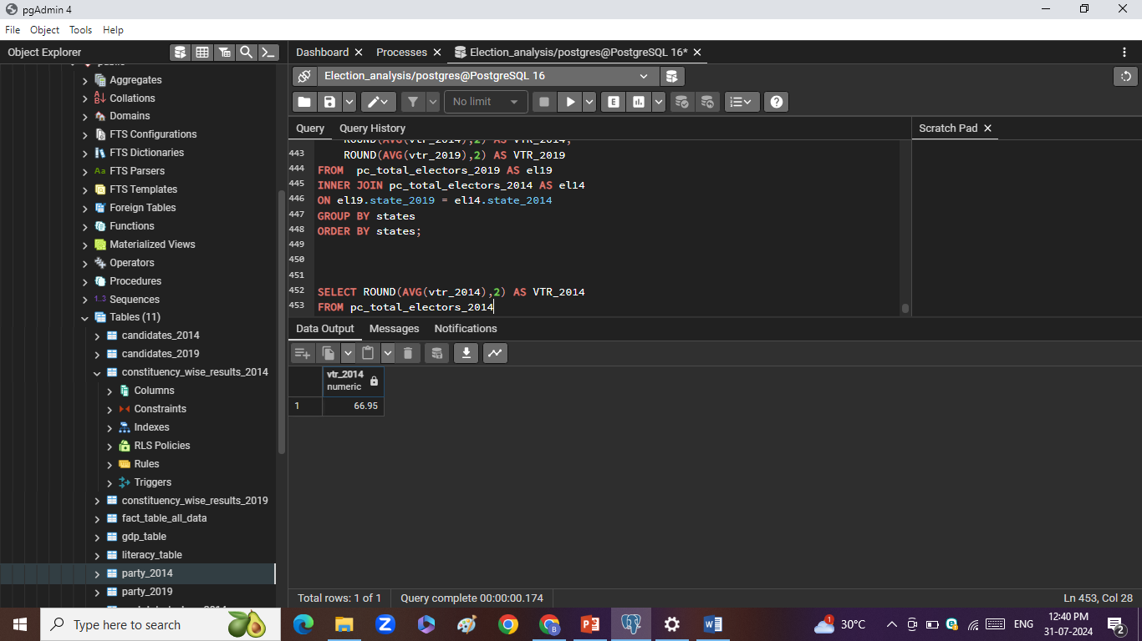
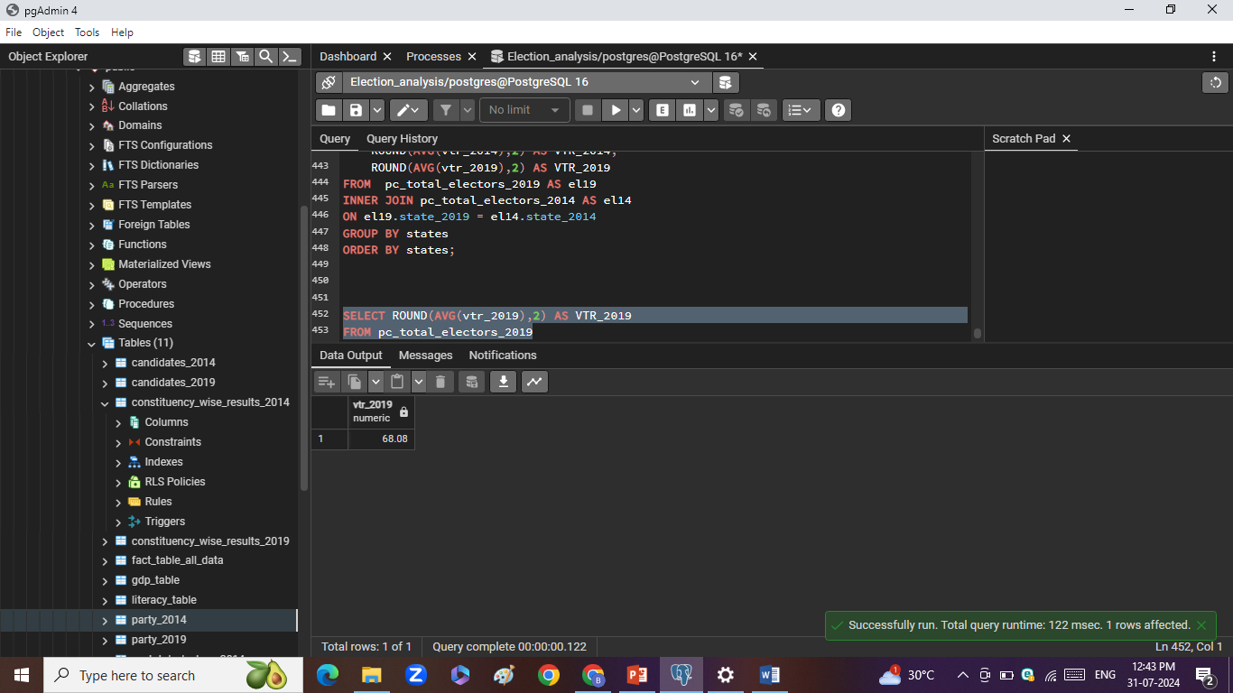
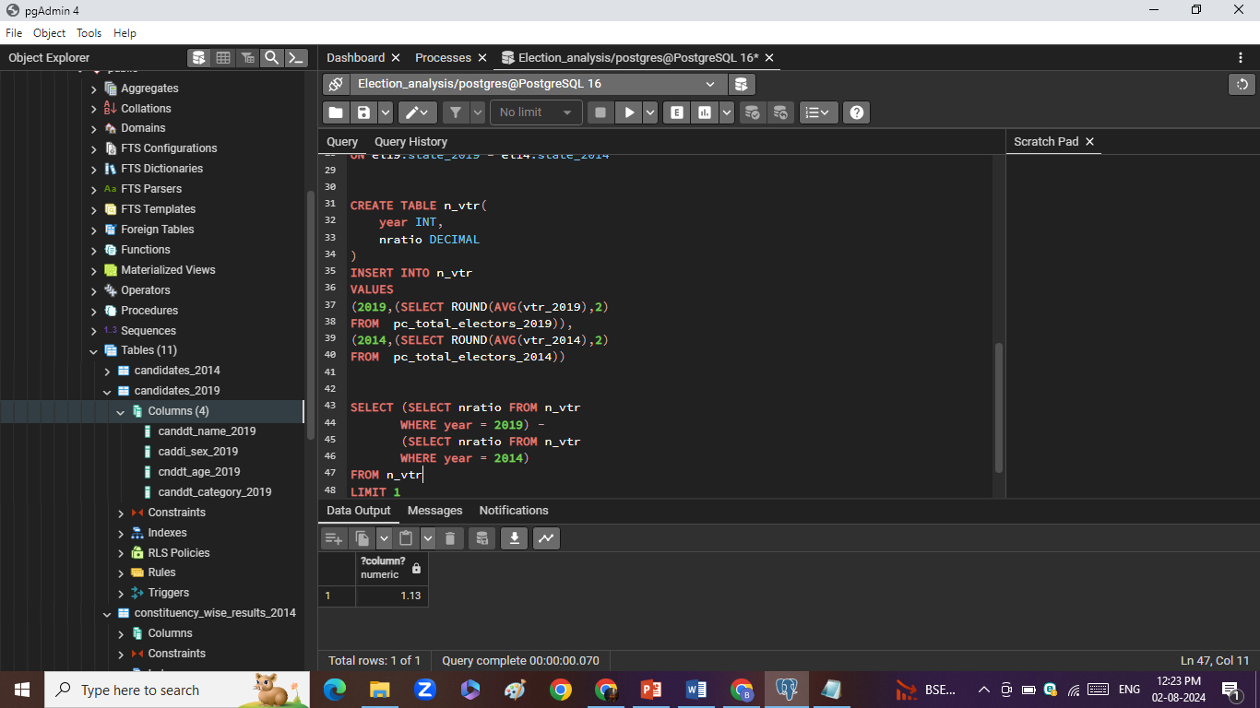
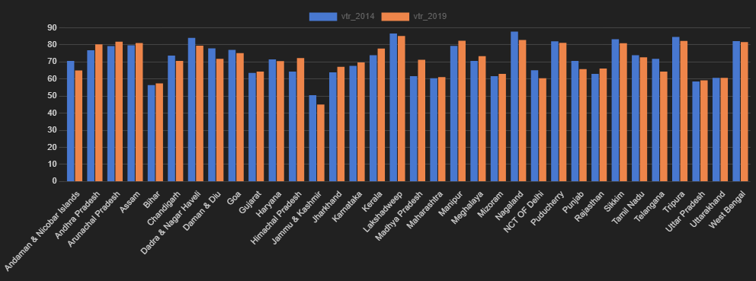
A. National Voter Turnout Ratio(%) in 2014
B. National Voter Turnout Ratio(%) in 2019
C. Rise in National Voter Turnout Ratio(%)
vtr_2014
vtr_2019
State wise voter turnout ratios for 2014 and 2019

Slide 8
States &
Voter Turnout Ratio

Slide 9
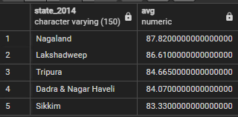
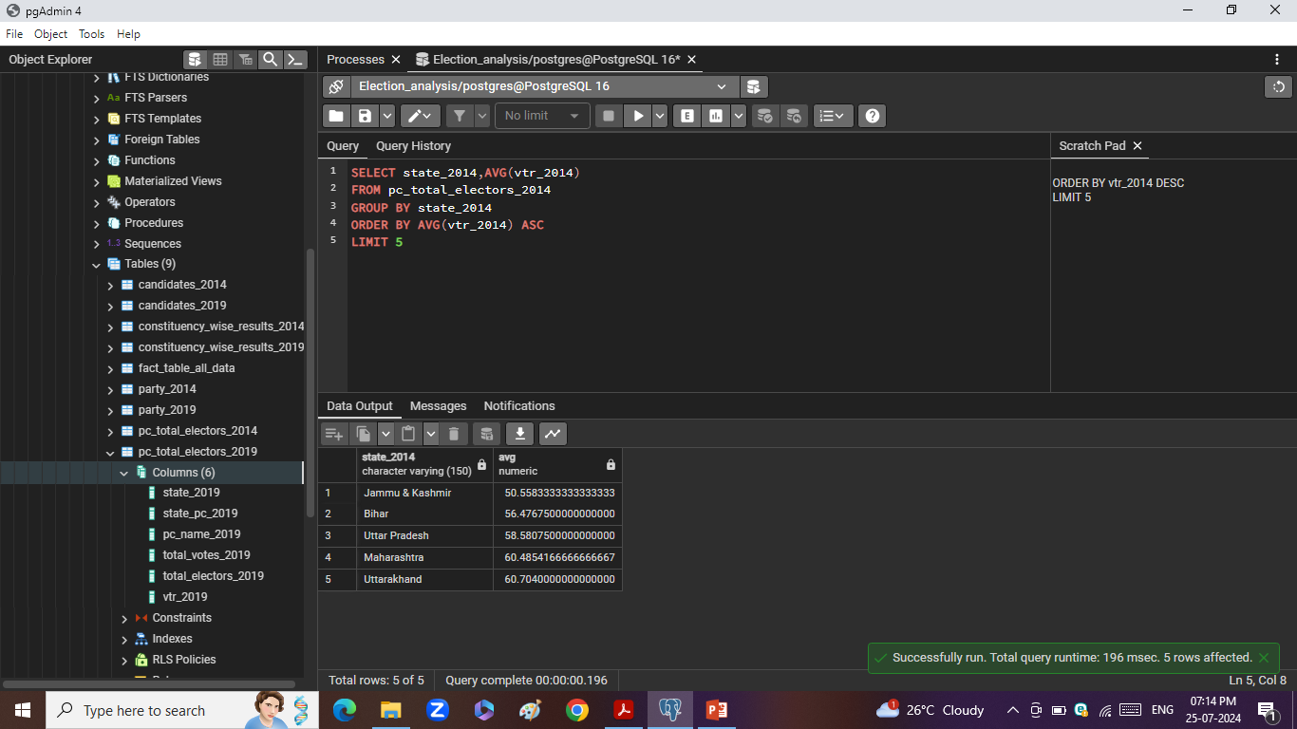
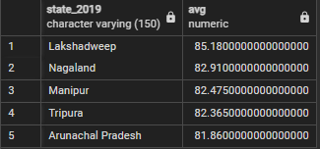

2.1. Top 5 States by voter turnout ratio in 2014
2.2. Bottom 5 States by voter turnout ratio in 2014
2.3. Top 5 States by voter turnout ratio in 2019
2.4. Bottom 5 States by voter turnout ratio in 2019

Slide 10
Constituencies &
Voter Turnout Ratio

Slide 11
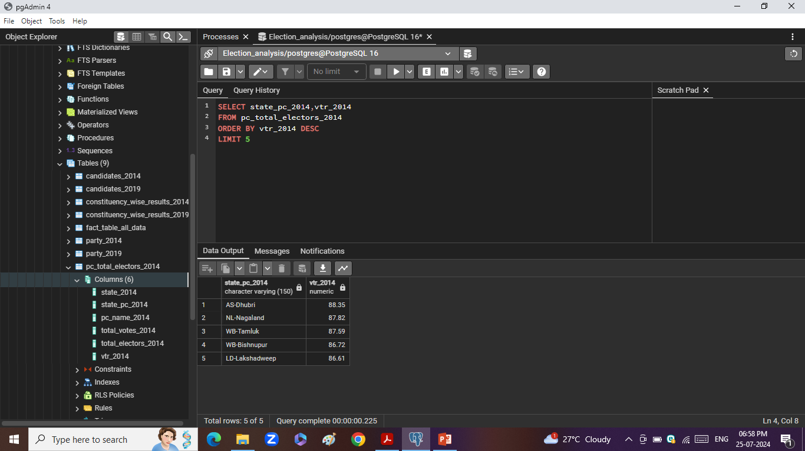

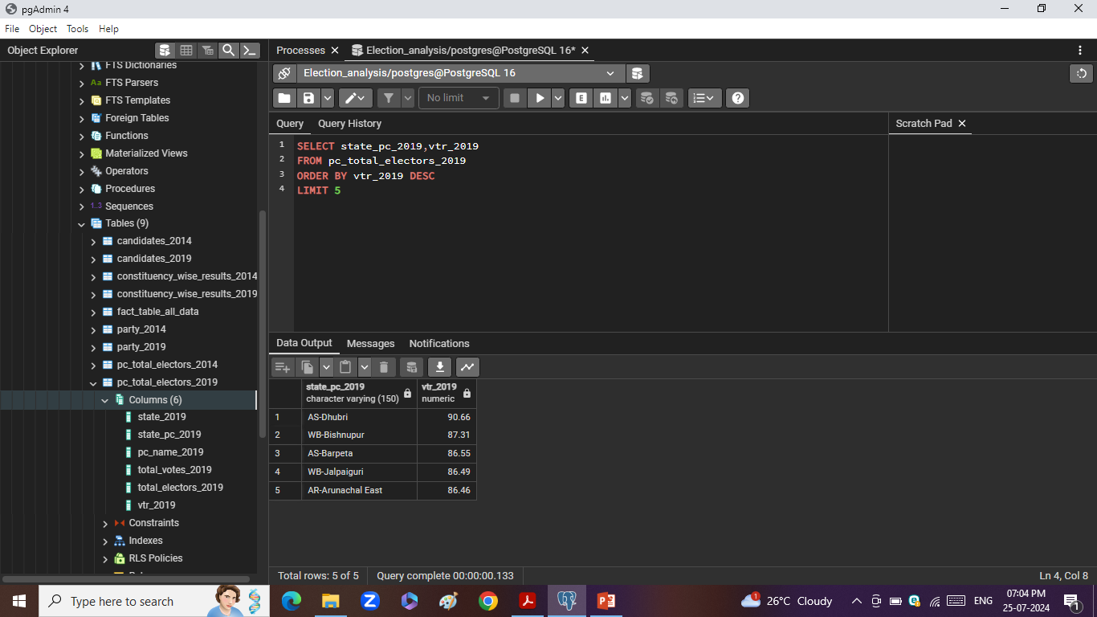

1.1. Top 5 PC by voter turnout ratio in 2014
1.2. Bottom 5 PC by voter turnout ratio in 2014
1.3. Top 5 PC by voter turnout ratio in 2019
1.4. Bottom 5 PC by voter turnout ratio in 2019

Slide 12
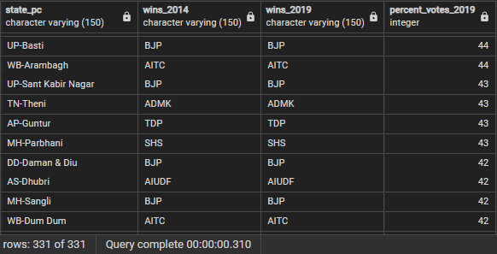
3. Constituencies which elected same party in general elections
of 2014 & 2019
331 constituencies elected same party in 2014 and 2019

Slide 13
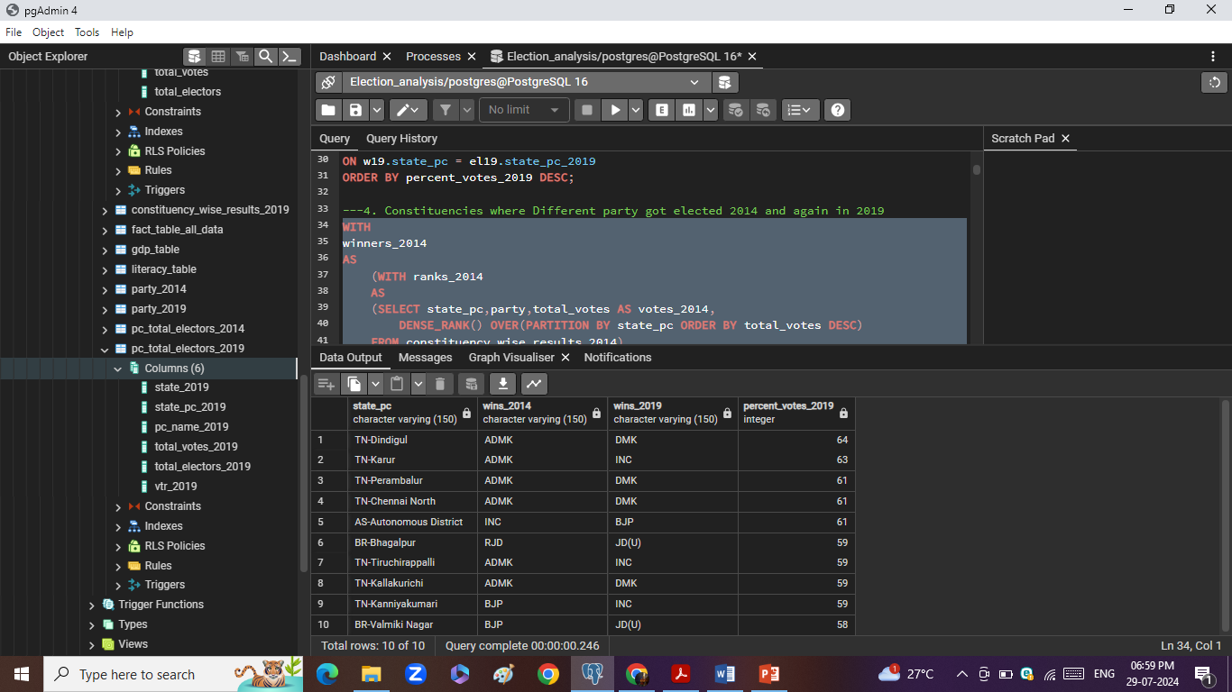
4. Top 10 Constituencies which elected different party in general
elections of 2014 & 2019
170 constituencies elected different party in 2014 and 2019

Slide 14
Candidate Analysis
Category_wise_winners_2014 :
Total Seats: 511
Category_wise_winners_2019
Total Seats: 543
Average_age_2014
Average_age_2019

Slide 15
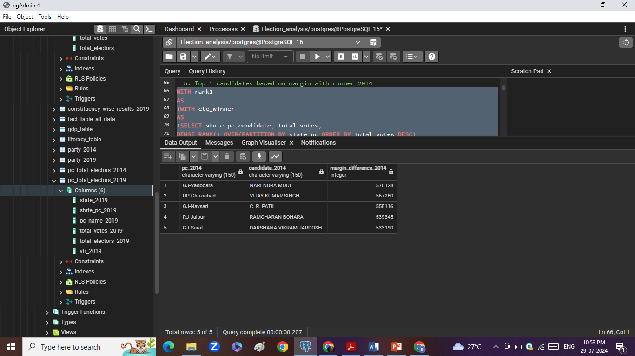
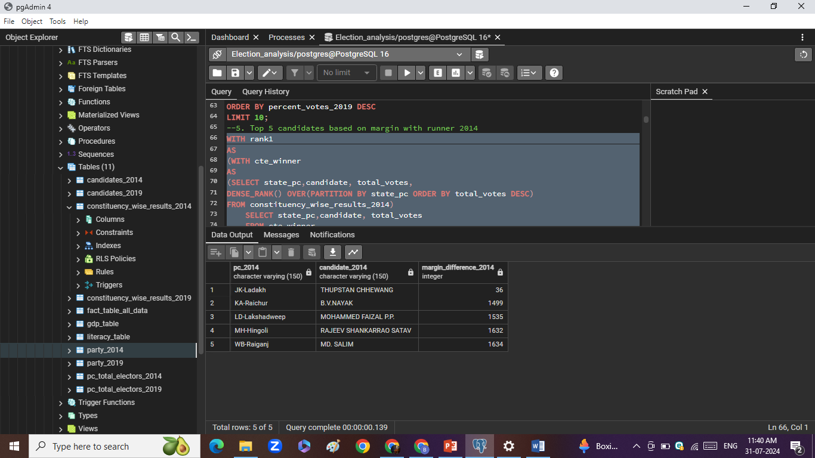
4.1 Top 5 Candidates winning with highest margin in 2014
4.2 Top 5 Candidates winning with least margin in 2014

Slide 16
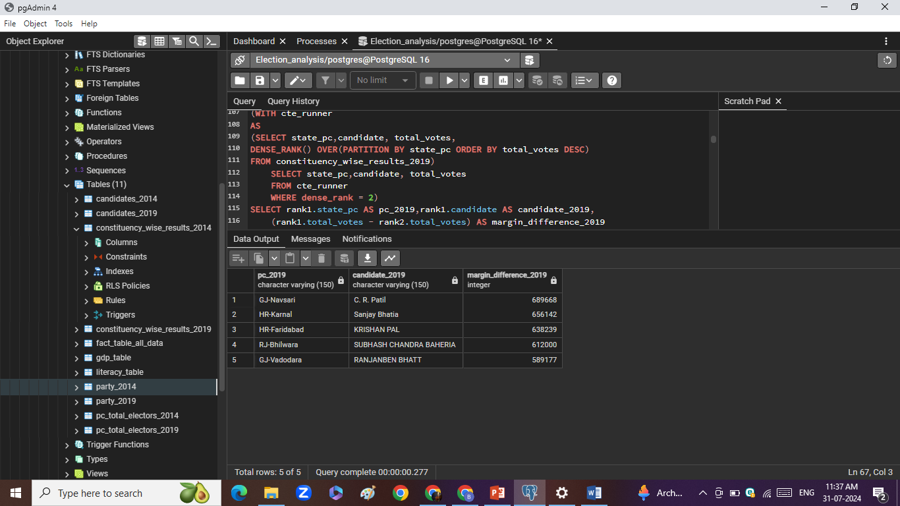
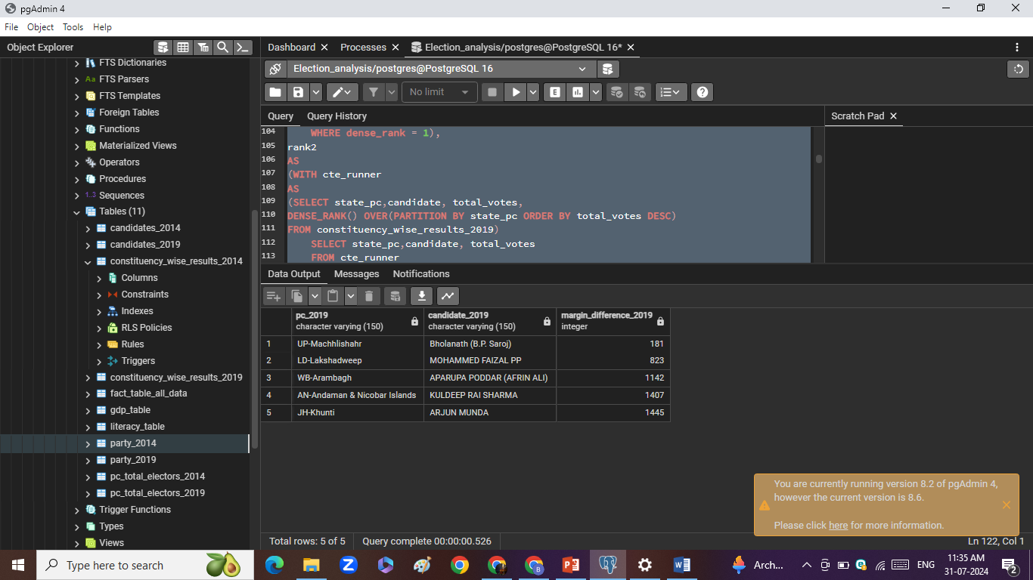
5.1 Top 5 Candidates winning with highest margin in 2019
5.2 Top 5 Candidates winning with least margin in 2019

Slide 17
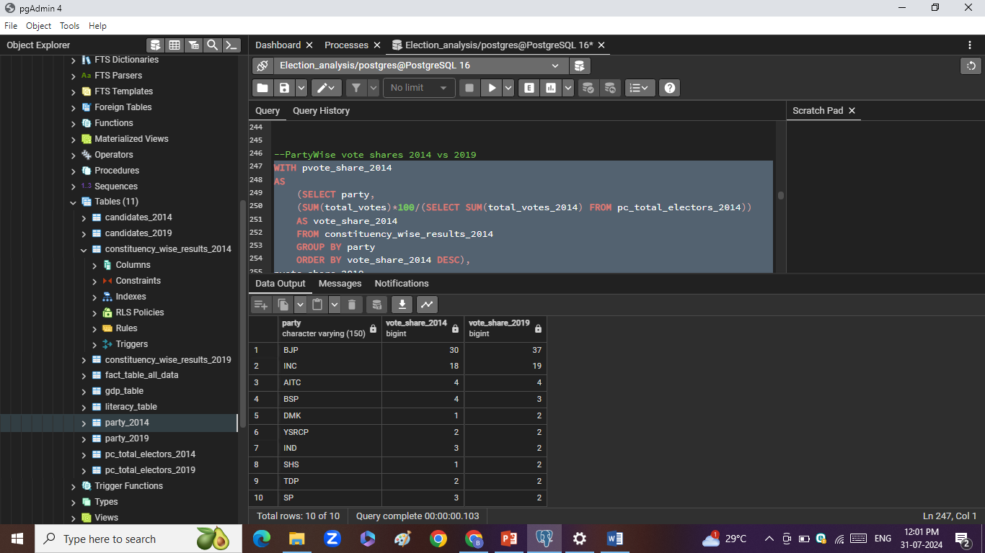
6. Top 10 Parties and there vote shares in general elections of 2014 & 2019

Slide 18
Performance analysis of
Top 2 National Parties
(BJP and INC)

Slide 19
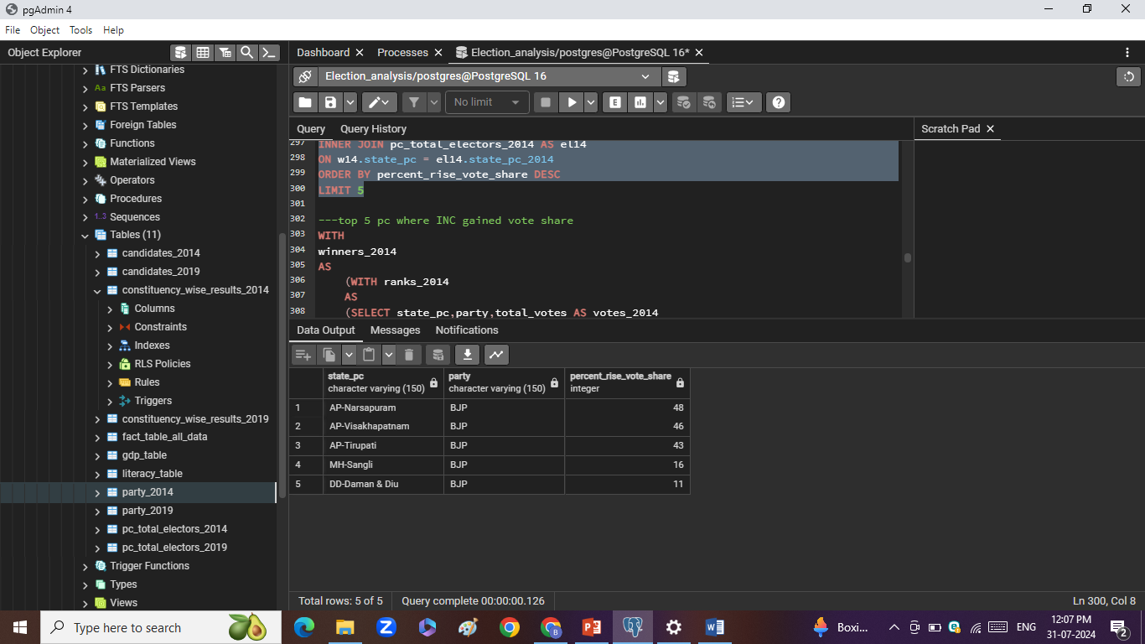
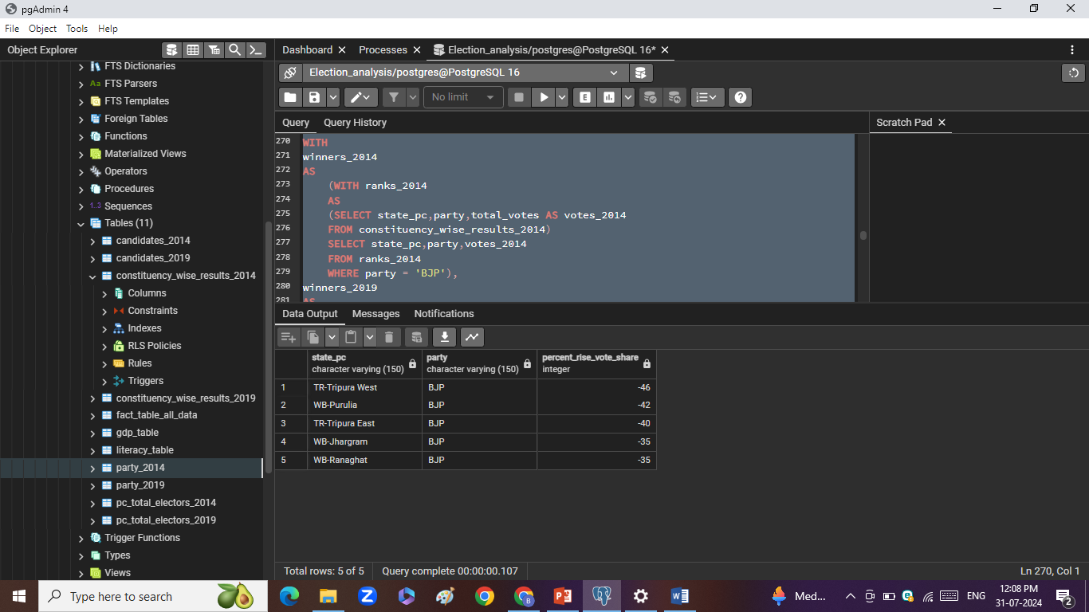
7. Top 5 constituencies where BJP registered GAIN and LOSS in vote share in
subsequent elections
GAIN
LOSS

Slide 20
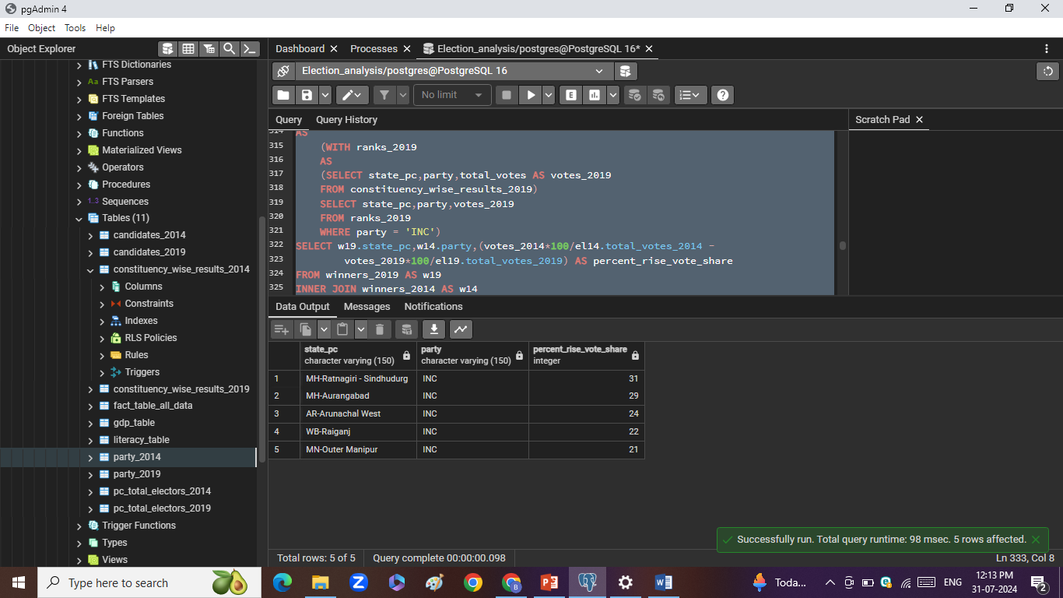
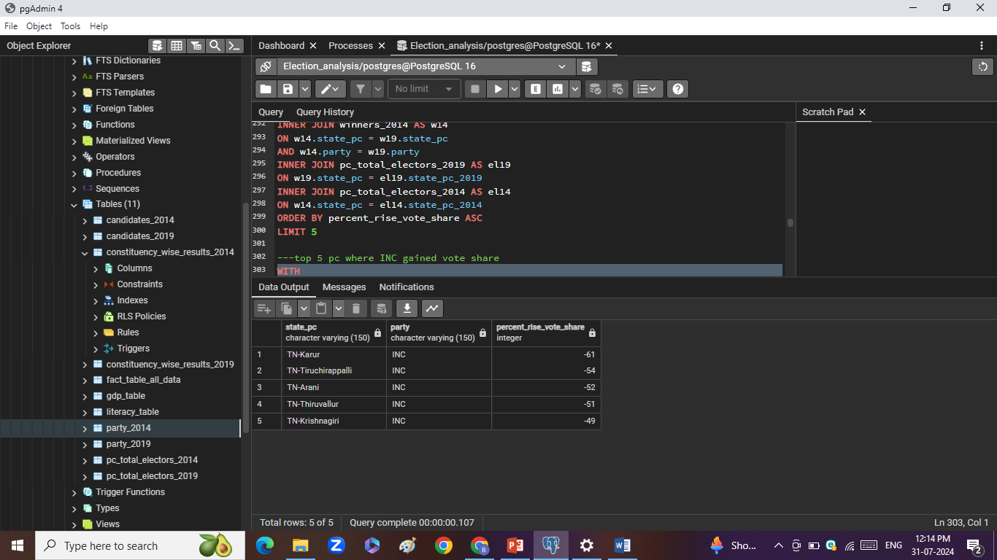
8. Top 5 constituencies where INC registered GAIN and LOSS in vote share in
subsequent elections
GAIN
LOSS

Slide 21
NOTA Votes Analysis

Slide 22
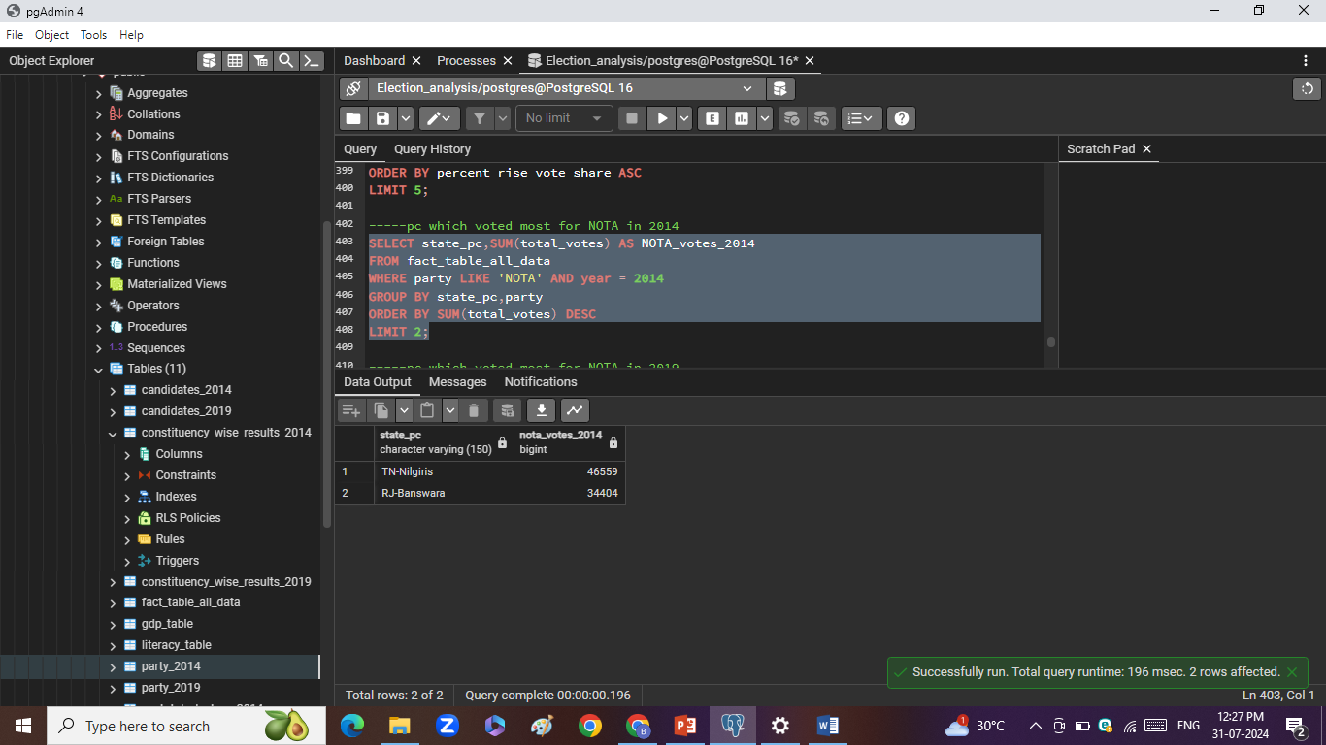
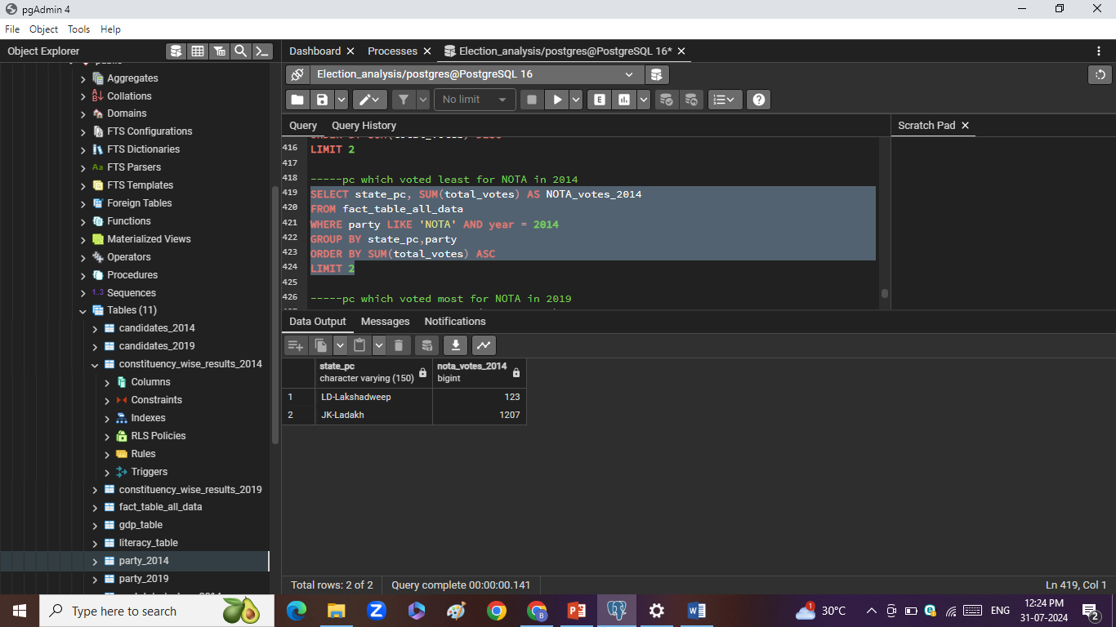
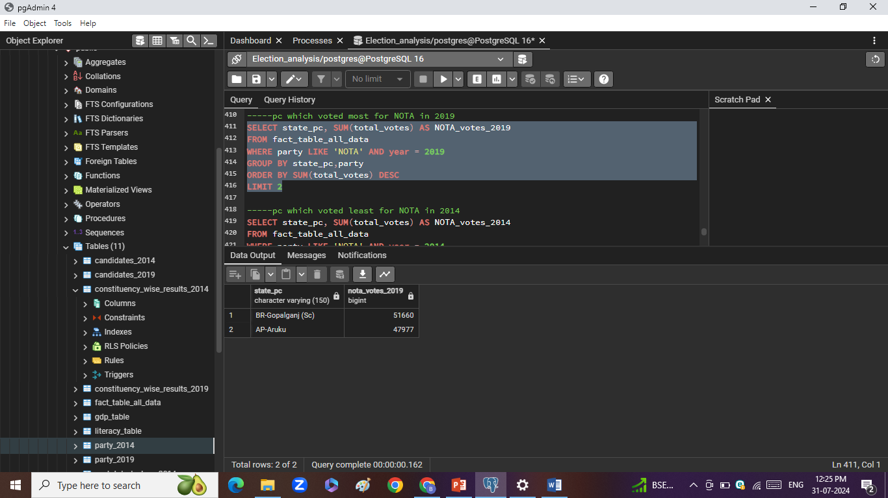
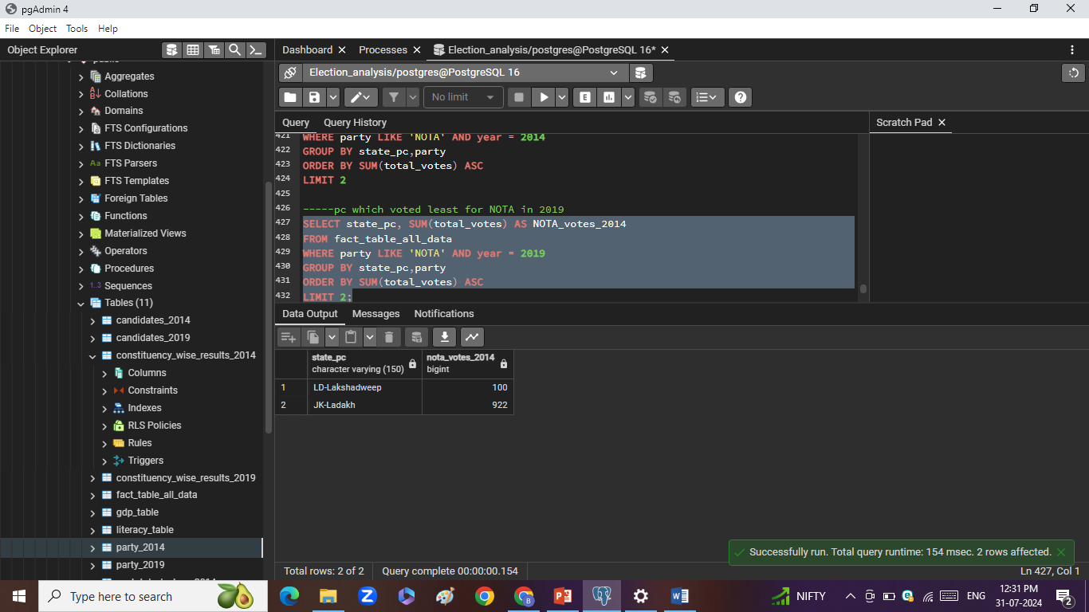
9.1 Top 2 Constituencies which
voted most for NOTA in 2014
9.2 Top 2 Constituencies which
voted least for NOTA in 2014
9.3 Top 2 Constituencies which
voted most for NOTA in 2019
9.4 Top 2 Constituencies which
voted least for NOTA in 2019

Slide 23
Literacy Ratio vs VTR analysis

Slide 24
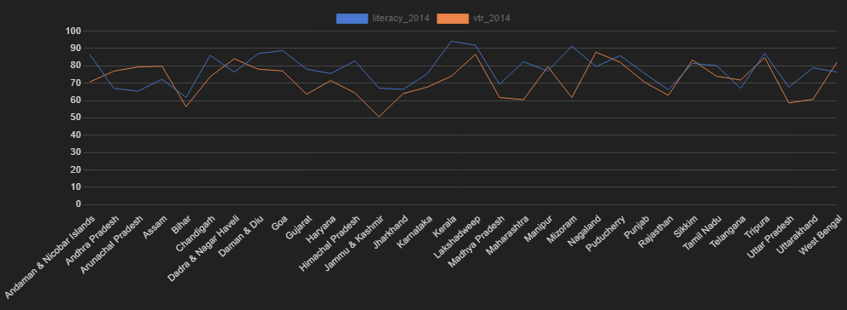
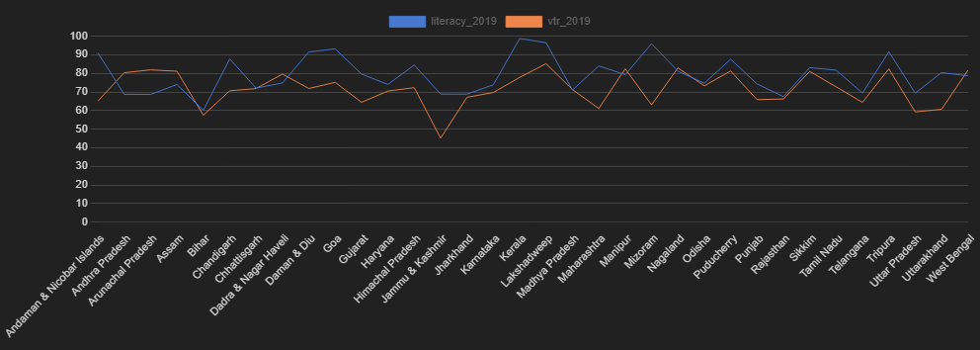
literacy_2014
vtr_2014
literacy_2019
vtr_2019

Slide 25
Recommendations
Voter Awareness Campaigns:
Covid-19 related lockdowns have added significant numbers in social media user world wide. In 2024, India have ____ active social media users. Targeted educational post and information disseminations on social media not just during elections but on national festivals like Independence Day, Republic Day too can significantly help in increasing eligible voters participation. There are many influencers on these platforms with wide and large followings. Making some as Ambassadors of Voting can be a good move.
Simple and Quick Registration:
Voter registration process can be improved with digital KYC and verification. Instead of applicant uploading documents,
Linking with digilocker can significantly increase ease of document verification and reduce overall application cycle.
Know Your Candidate:
Introduce this section on election commission website. Information like education, family backgrounds, cases against them and there gravity, properties and business of candidates, so on. This can allow voters to take informed decisions.

Slide 26




Thanks Giving
I extend my gratitude to codebasics team for providing with this opportunity to work on this project on my own.
With your clear and precise instructions, I could complete this project.
I learnt,
how to understand dataset,
How to comprehend questions and there context,
How to frame simple to complex SQL queries clearly,
And How to document project for non-tech professionals.
Heartfelt thank to Codebasics.
Regards
Bhavin Solanki
Data Analyst
+91 9518541005
bhavinsolanki326@gmail.com
bhavinsolanki326
Bhavinsolanki369

